Slide 1


STATISTICS
Session 1: Introduction to Statistics & Data

Slide 2
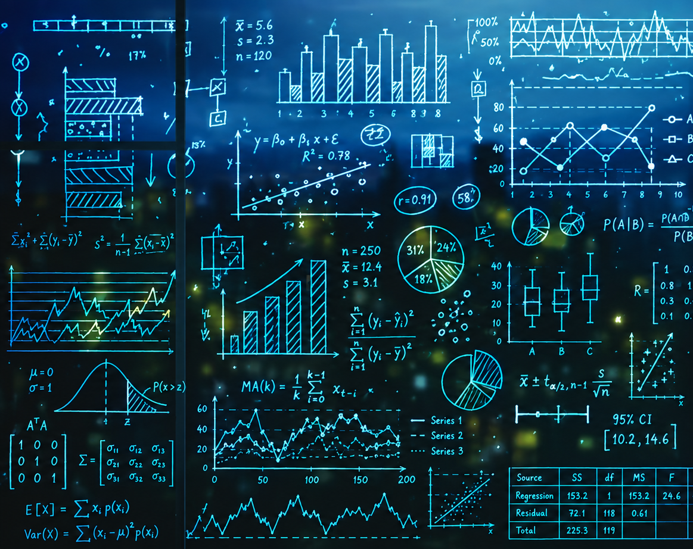
What is Statistics?
When people hear the word “statistics”, they tend to think about:
Numbers
Formulas
Calculations
Tables
Graphs
Averages
Percentages
However, statistics is not simply the calculation of numbers, and the art of making graphs look pretty.

Slide 3
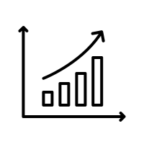
What is Statistics?
Statistics is the process of using data to:
Answer questions
Learn about the world
Make decisions when we do not have complete information.
For example, Statistics can help us to answer questions such as:
Is a new advertising campaign increasing sales?
Which customers are most likely to stop using a service?
Does a new medical treatment work?
Is a change in customer satisfaction meaningful, or could it simply be random variation?
What is likely to happen in the future?

Slide 4

Why study Statistics?
For students studying quantitative courses (e.g. mathematical sciences, economics and econometrics, etc.), they will naturally take several statistics units during their studies.
Students in other courses (e.g. Medicine, Psychology, Sport Science, Engineering, IT, Data Science, etc.) will usually take at least one statistics unit during their degree.
The question becomes, why do all students need statistical training at some point in their degree?
This is because statistics teaches you not just how to calculate but how to think: how to challenge claims, test assumptions, and make sense of messy real-world data.

Slide 5

Why study Statistics?
On 28 January 1986, the space shuttle Challenger exploded only about 70s after launch. This disaster was viewed by millions of people on live television.
Based upon previous tests:
  Engineers had warned that cold temperatures could affect the rocket’s O-ring seals.
  The analysis focused on flights with damage, leaving out flights with zero damage. That made the relationship between temperature and damage look unclear.
To assess the risk, the right statistical model would use all flights to estimate how the probability of damage changes with temperature.
NASA did not use the right statistical model and went ahead with the launch anyway.

Slide 6
Why study Statistics?
Not everyone here is going to work at NASA or be in a role where your decisions could cost lives.
However, every one of you will be expected to make decisions using data, whether you’re:
  managing a budget,
  launching a product,
  analyzing customer feedback, or
  pitching a new strategy to stakeholders.
Inaccurate assumptions, poor interpretation of trends, or blindly trusting a single number without questioning where it came from, these mistakes won’t make the news like the Challenger disaster did, but they can cost your company money, credibility, or opportunity.
And more importantly, they can damage your own confidence and reputation as a professional.

Slide 7

Data and Data Tables
Modern statistics focuses on using data and analytics to answer questions, understand uncertainty and make better decisions.
In particular, modern statistics has a large focus on making decisions with data.
  What data do we need?
  How to collect the data?
  Which methods are appropriate for analysing data?
  What conclusions can we make with the data?

Slide 8
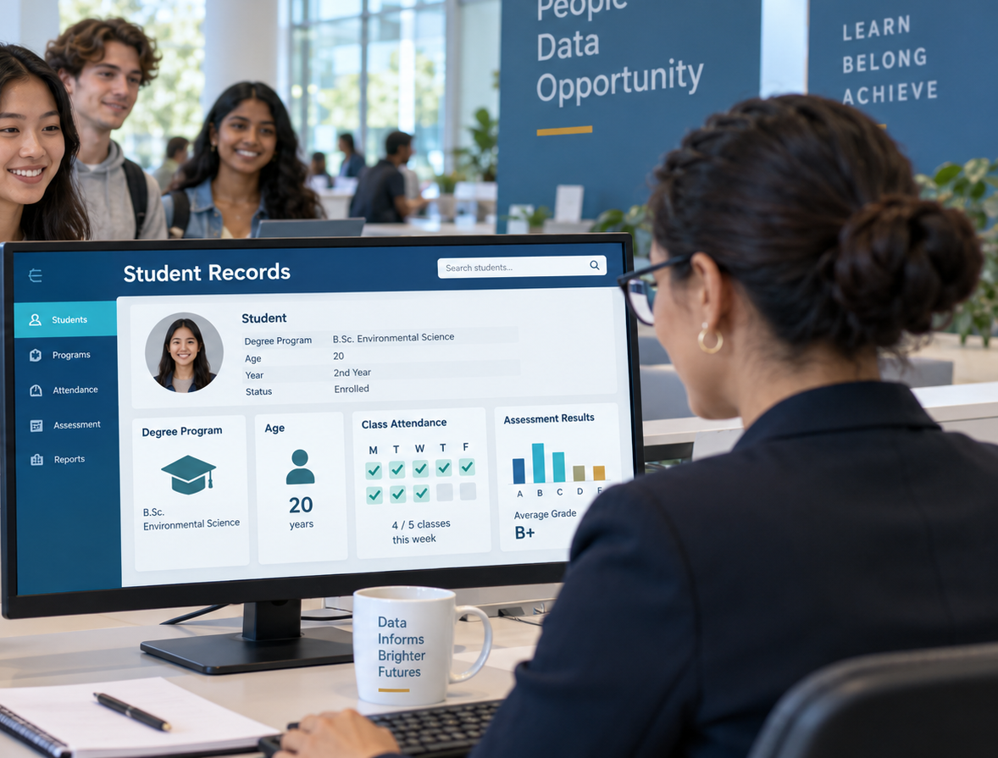
Data and Data Tables
Data are recorded pieces of information about people, objects, events or processes.
A university might record data about its students, including their degree, age, attendance and assessment results.
A business might record information about each sale, such as the product purchased, the price paid, the store location and the date of purchase.
A hospital might record a patient’s symptoms, test results, diagnosis and treatment outcomes.

Slide 9
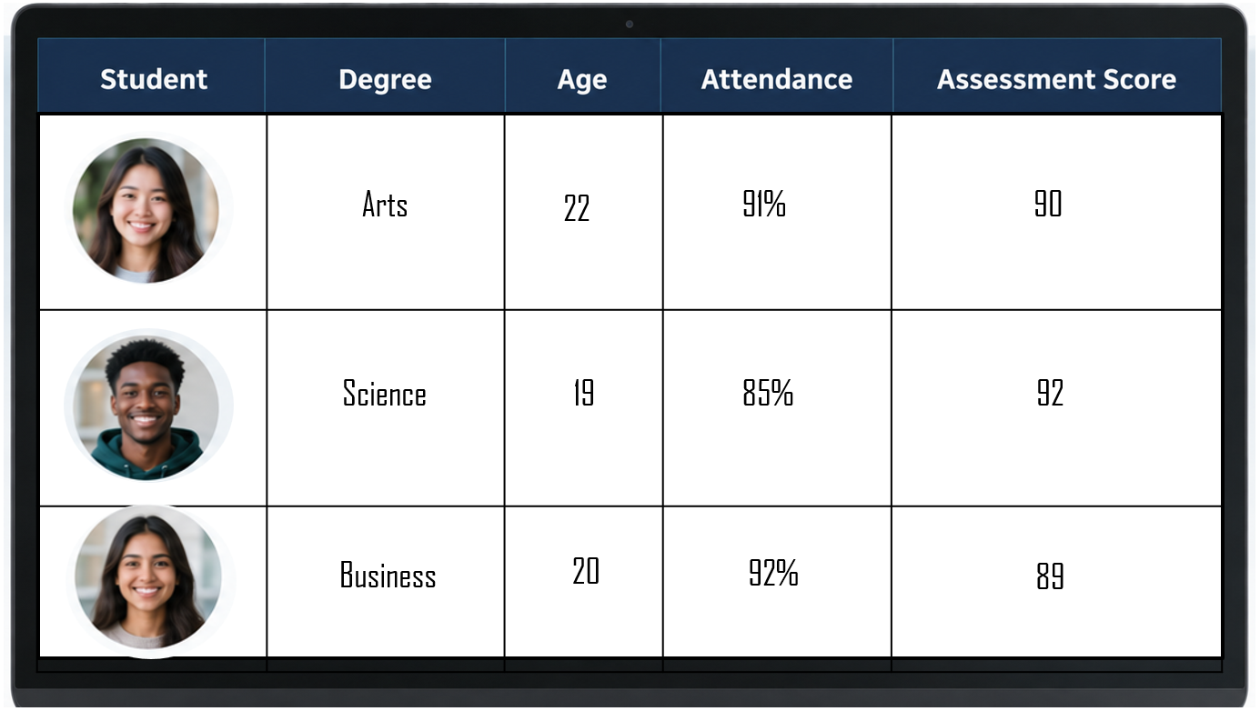
Data and Data Tables
The people, objects or events we collect information about are often called cases, observations or units.
The characteristics recorded for each case are called variables
When we analyse data, we need to begin by having it in a tabular format
A good data table will have the information organised where each row represents one case, and each column is one variable.
Each column is a variable

Slide 10
Where does data come from?
PRIMARY DATA
SECONDARY DATA
The researcher is directly involved in collecting the data. For example:
  a researcher might conduct a survey to understand people’s attitudes towards public transport.
  a researcher might run an experiment to compare the effectiveness of two medications.
Other data already exist because they were originally collected for another purpose. For example:
  A researcher might use government census data,
  hospital records,
  company sales data or
  information from an existing database.

Slide 11
Where does data come from?
Common sources of data includes:
Surveys and Questionnaires | People report their opinions, behaviours or characteristics
Experiments | Researchers deliberately change something and observe the outcome
Observational studies | Researchers observe what occurs without directly intervening
Administrative records | Such as enrolment records, tax records and medical records
Business transactions | Including purchases, payments and customer interactions
Sensors and devices | Such as fitness trackers, weather stations, satellites and GPS devices
Digital activity | Including website visits, online searches and interactions with apps or social media
The source of the data matters because data are not simply neutral facts that appear on their own.
Someone has decided what to measure, how to measure it, whom to include and when to collect it.

Slide 12
What do we do with data?
Before we do any analysis, we need to clean and organise our data. Real datasets may contain missing values, incorrect entries, inconsistent labels or duplicated observations.
The process of cleaning real data is time-consuming, but worth it, because the real fun happens after that.
With clean data, we then perform exploratory data analysis (EDA). Tables, graphs and summary statistics help us understand what has been observed.
But the true strength of statistics is to make conclusions beyond the available data. When you see research articles published in journals, or breaking news stories on television/online, these are usually based upon statistical inference.

Slide 13
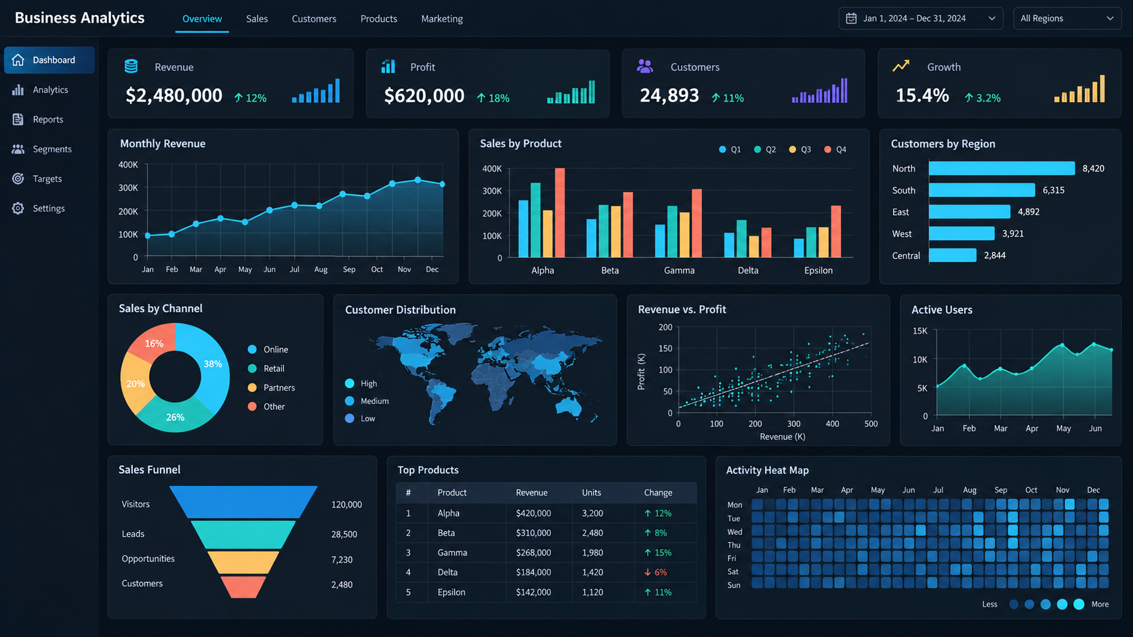
What do we do with data?

Slide 14
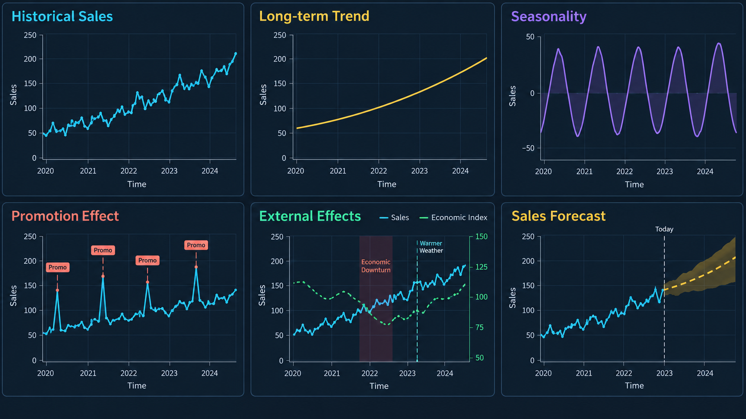

Slide 15
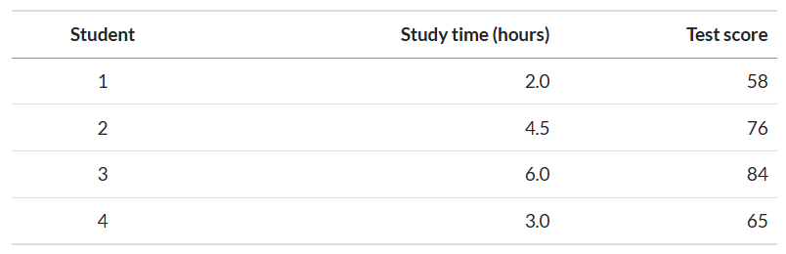
Variables
A variable is a characteristic or measurement that can take different values across observations.
The observations might be people, businesses, products, countries or points in time. For example, in a dataset containing information about students, each row might represent one student and each column might represent a variable.

Slide 16
Variables
The amount of studying and the test score can vary from one student to another. One student might study for two hours, while another might study for six hours. Their test scores may also differ.
Variables can also change for the same person over time. A student might study for five hours for one test but only two hours for another. The same student may obtain different scores across different assessments.
Therefore, variation can occur:
  between people, because different students may have different values;
  within a person, because the same student’s value may change over time.

Slide 17
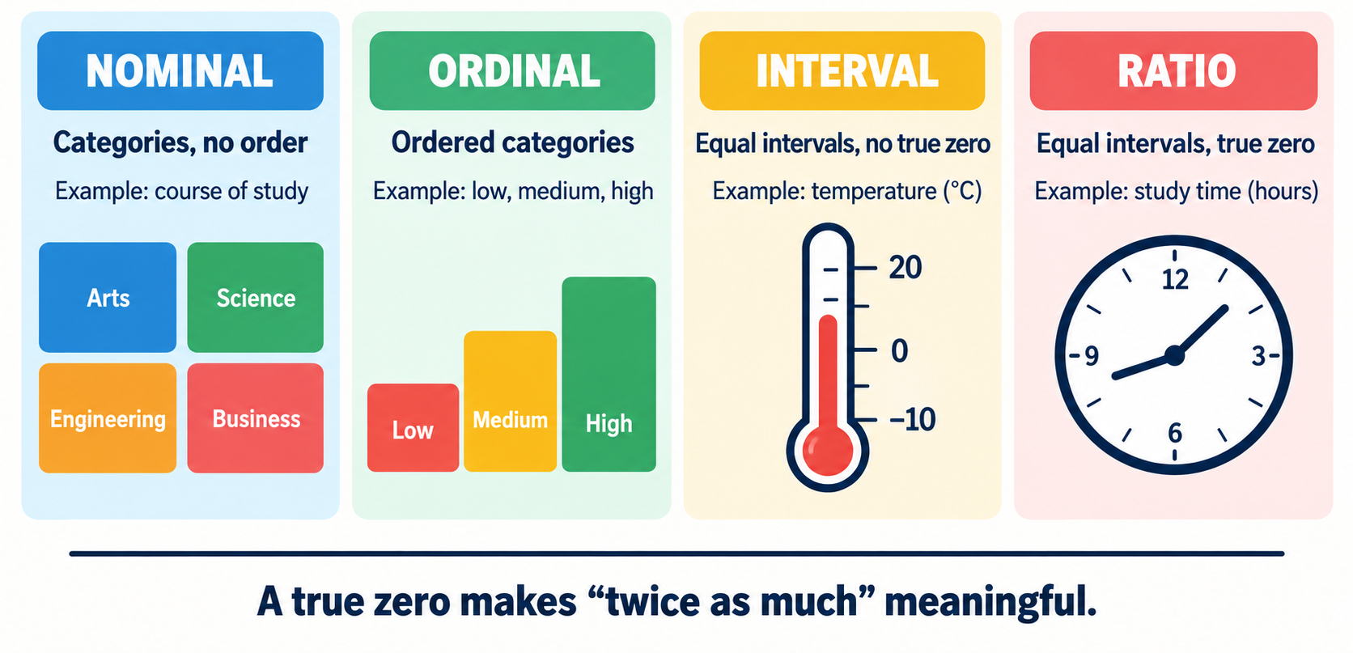
Levels of Measurement

Slide 18
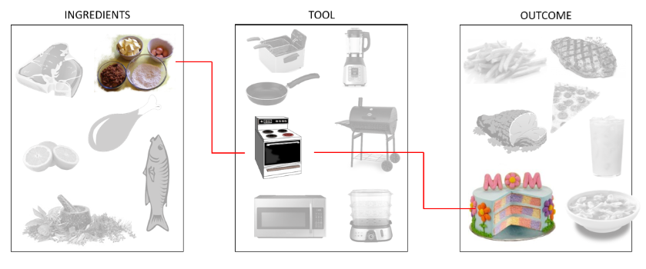
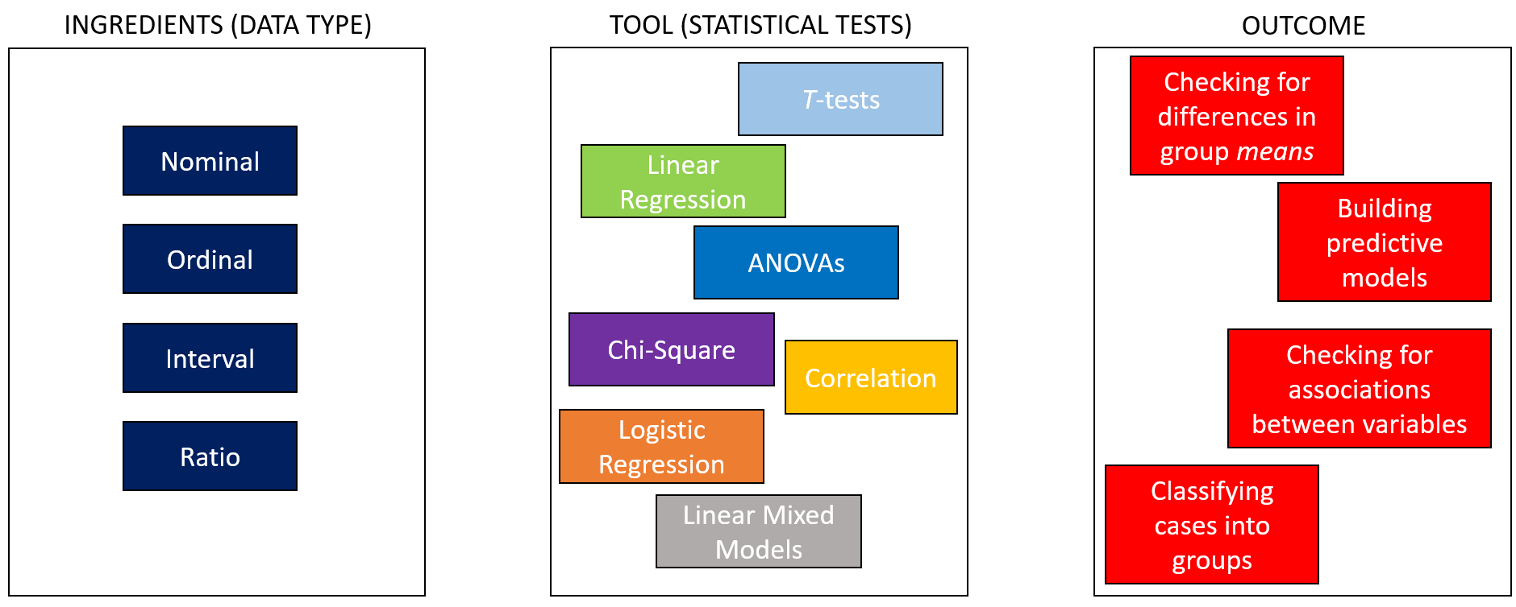
Statistics is a lot like cooking!
When cooking a dish, you need to use the right ingredients with the right tools, to obtain the desired outcome! The same principal applies in Statistics as well.
If we use the wrong statistical tool for the data at hand, our results may be misleading or invalid, just like trying to bake a cake in a deep fryer.

Slide 19
Explanatory and outcome variables
When investigating a relationship, variables are often described according to the role they play in the research question.
  An outcome variable is the variable we want to understand, explain or predict. It represents the result of interest.
  An explanatory variable is a variable that may help explain or predict variation in the outcome variable.
Explanatory variable
Outcome variable

Slide 20
Explanatory and outcome variables
Explanatory variable
Outcome variable
An explanatory variable is a variable that might explain, influence or predict changes in another variable.
It represents the possible reason why outcomes differ. Depending on the context, it may also be called a predictor, independent variable, input or risk factor.
An explanatory variable can be:
  Categorical, such as treatment group, teaching method or employment type.
  Numeric, such as age, temperature, advertising expenditure or hours of sleep.
An outcome variable is the variable we want to understand, explain or predict.
It records the result or response of interest. Depending on the context, it may also be called a response, dependent variable or target.
An outcome variable can also be:
  Categorical, such as whether a patient recovered, whether a customer made a purchase
  Numeric, such as recovery time, sales revenue, examination score or stress level.

Slide 21
Explanatory and outcome variables
Explanatory variable
Outcome variable
Causes
What might help explain or predict it?
What are we trying to explain or predict?

